Slide 1
Estimation Using R

Slide 2
Simulating a random sample from a distribution
N(0,1) : sample size 5
rnorm(5)
[1] -1.539950042 -0.928567035 -0.294720447 -0.005767173 2.404653389
rnorm(5)
[1] 0.7635935 -0.7990092 -1.1476570 -0.2894616 -0.2992151

Slide 3
N(0,1) : sample size 50
rnorm(50)
[1] -0.41151083 0.25222345 -0.89192113 0.43568330 -1.23753842 -0.22426789
[7] 0.37739565 0.13333636 0.80418951 -0.05710677 0.50360797 1.08576936
[13] -0.69095384 -1.28459935 0.04672617 -0.23570656 -0.54288826 -0.43331032
[19] -0.64947165 0.72675075 1.15191175 0.99216037 -0.42951311 1.23830410
[25] -0.27934628 1.75790309 0.56074609 -0.45278397 -0.83204330 -1.16657055
[31] -1.06559058 -1.56378205 1.15653700 0.83204713 -0.22732869 0.26613736
[37] -0.37670272 2.44136463 -0.79533912 -0.05487747 0.25014132 0.61824329
[43] -0.17262350 -2.22390027 -1.26361438 0.35872890 -0.01104548 -0.94064916
[49] -0.11582532 -0.81496871

Slide 4
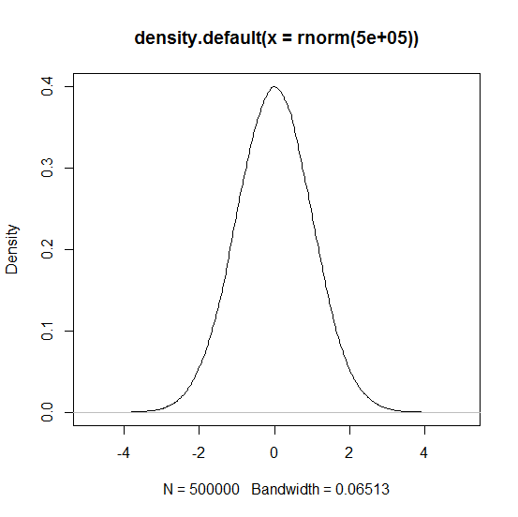
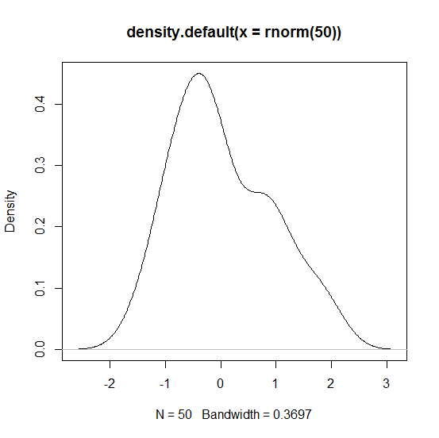
Comparison for varying sample size
plot(density(rnorm(50)))
plot(density(rnorm(500000)))

Slide 5
Normal Distribution
Command | Explanation
rnorm(n, mean = 0, sd = 1) | Generates n random numbers from the normal distribution with mean of 0 and standard deviation of 1
pnorm(q, mean = 0, sd = 1) | Returns the probability for the quantile q
qnorm(p, mean = 0, s d = 1) | Returns the quantile for a given probability p
dnorm(x, mean = 0, sd = 1) | Gives the value of the density function for values x

Slide 6
Examples
pnorm(0) # gives cdf value
[1] 0.5
qnorm(0.5)
[1] 0
dnorm(0) # gives pdf value
[1] 0.3989423

Slide 7
Beyond Standard Normal
rnorm(5,2,3)
[1] 3.7916942 3.0862985 1.1134344 2.9722064 -0.3640922
rnorm(50,2,3)
[1] 3.74403366 1.86807316 -1.66184731 0.11030993 4.73653386 2.49002944
[7] 3.34664251 2.62933362 0.87865624 0.17993568 2.94334725 0.54119441
[13] 0.37823261 4.43263548 2.23655270 -0.25950544 3.14790752 0.58279648
[19] 1.57789818 1.69962161 4.13134508 0.77419936 1.97542637 1.09057528
[25] 6.00485152 2.80658087 2.94065272 7.43581501 4.53259530 3.54321499
[31] 4.54376425 0.05735626 7.47229254 -2.13443949 3.86046902 -1.97986399
[37] -0.74641488 3.96990209 3.38351478 -1.31210114 3.72154717 -1.34682163
[43] 2.50268110 6.93911070 2.75785074 4.26661121 3.39362867 -1.65923773
[49] 2.32429547 3.56447817

Slide 8
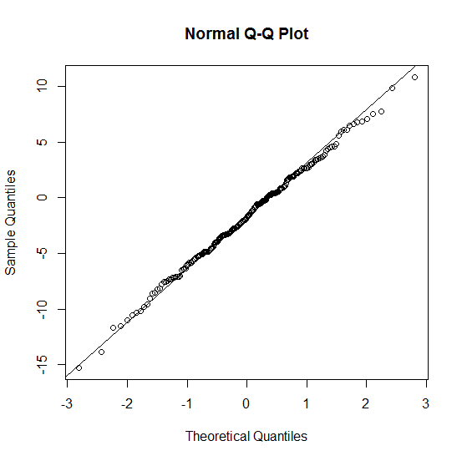
Normal Q-Q plot
qqnorm(y)
qqline(y)

Slide 9
Shapiro-Wilk Normality Test
shapiro.test(rnorm(50))
Shapiro-Wilk normality test
data: rnorm(50)
W = 0.97887, p-value = 0.5055

Slide 10
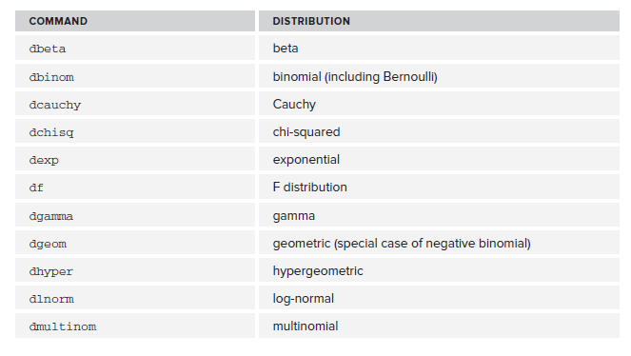
List of Some Useful Distributions

Slide 11
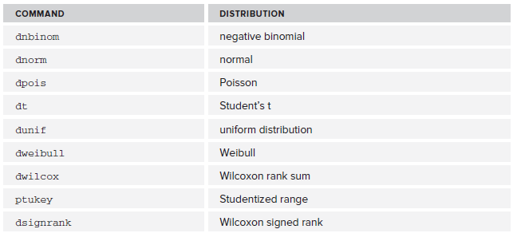

Slide 12
Method of Moments Estimation (MME)

Slide 13
Generating data from,say, a N(5, 9) distribution and using the MME to see if we can get close to the original parameters.

Slide 14
# replicate
n<-5
mu<-5
sigma<-3
samples<-replicate(rnorm(n, mu, sigma),n=100)
samples
sample_means<-apply(samples,2, mean)
sample_means
sample_var<-apply(samples,2,function(x) {return((1/n)*sum(x^2)-sum(x/n)^2)})
sample_var
# check if estimates are close:
mean(sample_means);
mean(sample_var)

Slide 15
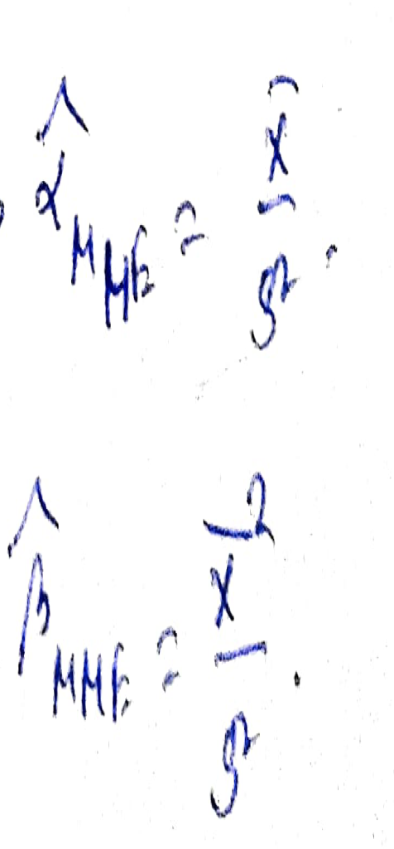

MME for Gamma (5,7) distribution

Slide 16
# MME from Gamma (5, 7)
#Replicate
x<-rgamma(1000,5,7)
# calculate MoM estimates
mu_1<-mean(x)
mu_2<-mean(x^2)
beta_MME<-mu_1^2/(mu_2-mu_1^2)
alpha_MME<-mu_1/(mu_2-mu_1^2)

